Slide 2
Shenny

Slide 3
For there is one God and one mediator between God and mankind, the man Christ Jesus
(I Timothy 2:5)

Slide 4
Jesus is
“the stone you builders rejected, which has become the cornerstone.”
Salvation is found in no one else, for there is no other name under heaven given to mankind by which we must be saved.
(Acts 4:11-12)

Slide 5
For God so loved the world that he gave his one and only Son, that whoever believes in him shall not perish but have eternal life. For God did not send his Son into the world to condemn the world, but to save the world through him…

Slide 6
…Whoever believes in him is not condemned, but whoever does not believe stands condemned already because they have not believed in the name of God’s one and only Son.
(John 3:16-18)

Slide 7
Jesus answered, “I am the way and the truth and the life. No one comes to the Father except through me.
(John 14:6)

Slide 8
“These statements are direct, unequivocal, and unapologetic. They were, in their day as much as in our own, viewed with cynicism and distaste.

Slide 9
But as the apostles became convinced of the truth that Jesus had risen from the dead and the reality that He was God made flesh, the implication was unavoidable: there is no other Savior, because there is no other person who is qualified to save.”
Alistair Begg

Slide 11
…for, “Everyone who calls on the name of the Lord will be saved.”
How, then, can they call on the one they have not believed in? And how can they believe in the one of whom they have not heard? And how can they hear without someone telling them?
(Romans 10:13-14)

Slide 12
WHY should I care?
WHAT should I do?

Slide 13
II Kings 6:24-7:9

Slide 14
Some time later, Ben-Hadad king of Aram mobilized his entire army and marched up and laid siege to Samaria.
(II Kings 6:24)

Slide 15
There was a great famine in the city; the siege lasted so long that a donkey’s head sold for eighty shekels of silver, and a quarter of a cab of seed pods for five shekels.
(II Kings 6:25)

Slide 16
As the king of Israel was passing by on the wall, a woman cried to him, “Help me, my lord the king!” The king replied, “If the Lord does not help you, where can I get help for you? From the threshing floor? From the winepress?” Then he asked her, “What’s the matter?”
(II Kings 6:26-28)

Slide 17
She answered, “This woman said to me, ‘Give up your son so that we may eat him today, and tomorrow we’ll eat my son.’ So, we cooked my son and ate him. The next day I said to her, ‘Give up your son so that we may eat him,’ but she had hidden him.”
(II Kings 6:28-29)

Slide 18
Now there were four men with leprosy at the entrance of the city gate.
(II Kings 7:3)

Slide 19
“…wear torn clothes, let his hair be unkempt, cover the lower part of his face and cry out, ‘Unclean! Unclean!’ and must live alone and outside the camp.”
(Leviticus 13:45-46)

Slide 20
They said to each other, “Why stay here until we die? If we say, ‘We’ll go into the city’– the famine is there, and we will die. And if we stay here, we will die. So let’s go over to the camp of the Arameans and surrender. If they spare us, we live; if they kill us, then we die.
(II Kings 7:3-4)

Slide 21
At dusk they got up and went to the camp of the Arameans. When they reached the edge of the camp, no one was there, for the Lord had caused the Arameans to hear the sound of chariots and horses and a great army, …

Slide 22
…so that they said to one another, “Look, the king of Israel has hired the Hittite and Egyptian kings to attack us!” So they got up and fled in the dusk and abandoned their tents and their horses and donkeys. They left the camp as it was and ran for their lives.
(II Kings 7:5-7)

Slide 23
The men who had leprosy reached the edge of the camp, entered one of the tents and ate and drank. Then they took silver, gold and clothes, and went off and hid them. They returned and entered another tent and took some things from it and hid them also.
(II Kings 7:7-8)

Slide 24
“We’re not doing right. This is a day of good news and we are keeping it to ourselves. If we wait till daylight, punishment will overtake us. Let’s go at once and report this to the royal palace.”
(II Kings 7:9)

Slide 25
“We’re not doing right. This is a day of good news and we are keeping it to ourselves. If we wait till daylight, punishment will overtake us. Let’s go at once and report this to the royal palace.”
(II Kings 7:9)

Slide 26
It is just not right to withhold
the message that will save
from the
multitude who won’t survive.

Slide 27
WHY should I care?
WHAT should I do?

Slide 28
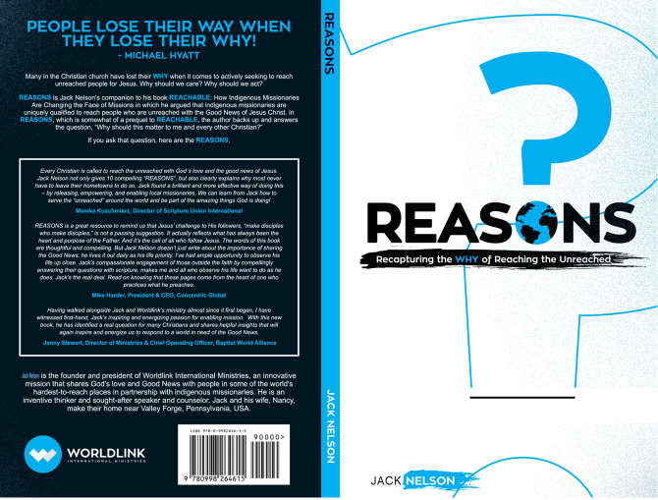
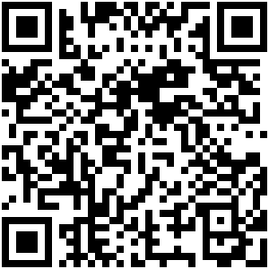
Scan to Order

Slide 29
Scan For Audio

Slide 30
WHY should I care?
WHAT should I do?

Slide 32
Vision
To see God’s Good News shared with every unreached person transforming individuals and communities

Slide 33
Mission
To empower indigenous missionaries to share the tangible love of God and the Good News of Jesus with the world’s least-reached people

Slide 34
1318 Indigenous Missionaries
49 Countries
1,240,870 Heard
98,872 Trusted Christ

Slide 35
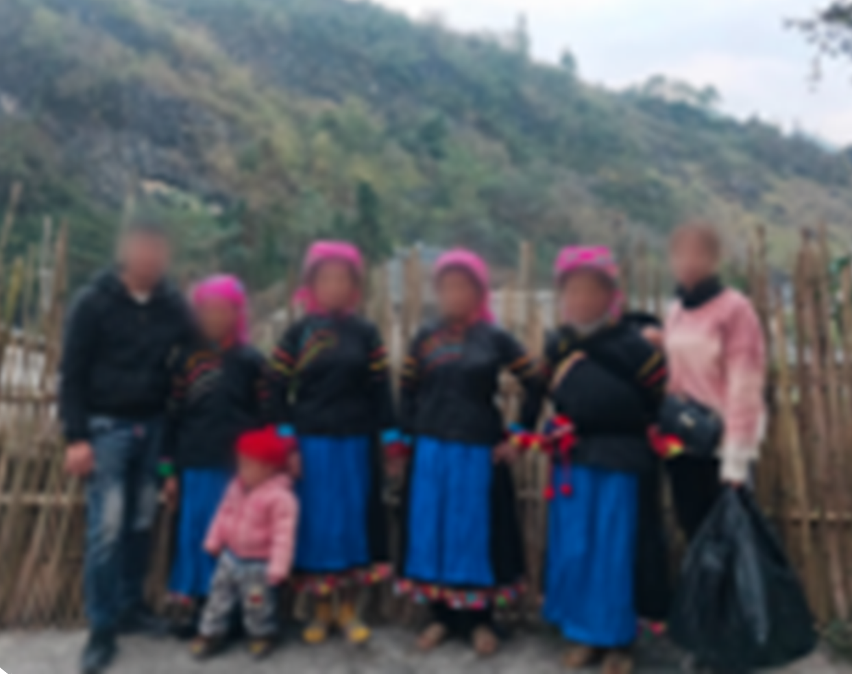

Slide 36
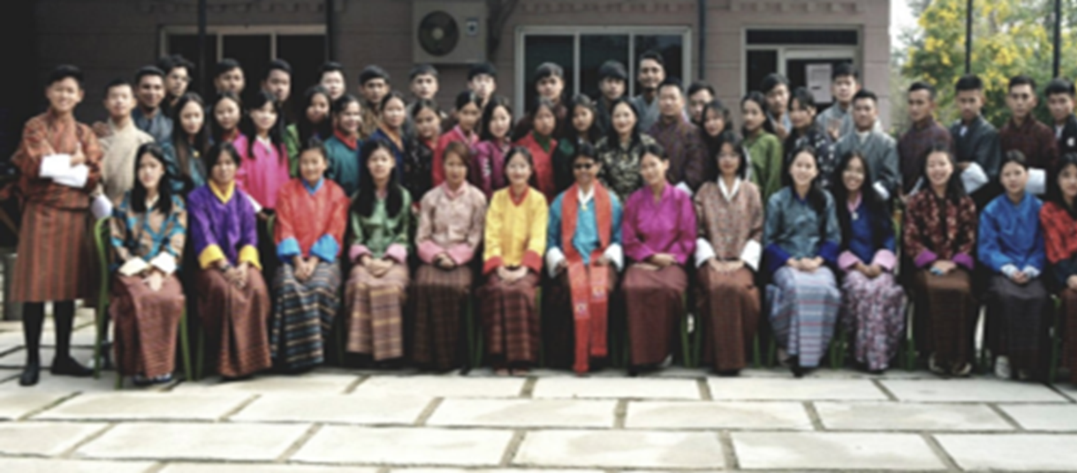

Slide 37
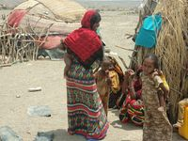

Slide 38
Thank God for You

Slide 39
It is just not right to withhold
the message that will save
from the
multitude who won’t survive.

